Slide 1
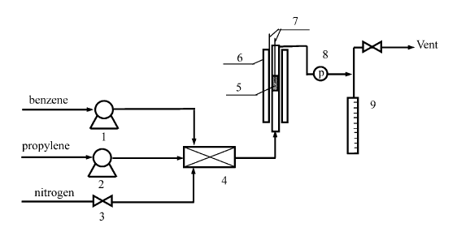
Optimization of series reaction in PFR
By,
Anirudh V Veliyur
20CHE191

Slide 2
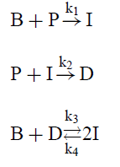
Alkylation of Benzene to Cumene
B=Benzene
P=Propylene
I=Cumene
D=Dialkylbenzene

Slide 3
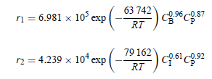

Slide 4


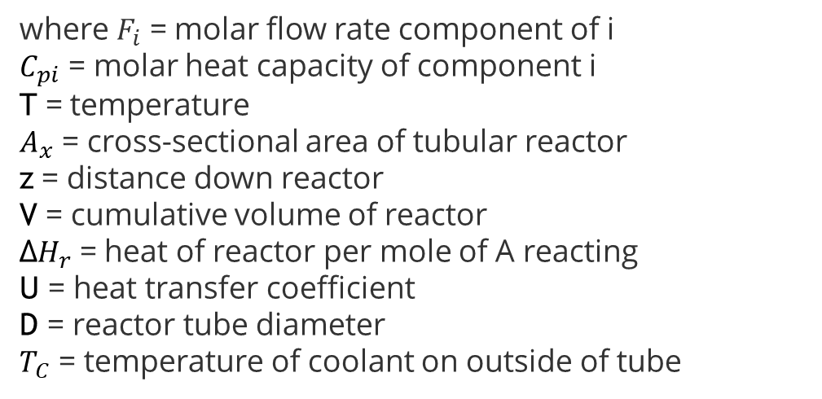
Energy balance for steady-state PFR-tubular reactor where A is reactant
The corresponding mass balances to be solved simultaneously with the energy balance are :
where $F_{i}$ = molar flow rate component of i $C_{pi}$ = molar heat capacity of component i T = temperature $A_{x}$ = cross-sectional area of tubular reactor z = distance down reactor V = cumulative volume of reactor Δ$H_{r}$ = heat of reactor per mole of A reacting U = heat transfer coefficient D = reactor tube diameter $T_{C}$ = temperature of coolant on outside of tube

Slide 5
References
https://learncheme.com/quiz-yourself/interactive-self-study-modules/energy-balance-in-steady-state-pfr/energy-balance-in-steady-state-pfr-screencasts/
Torres-Rodríguez, Miguel; Gutiérrez-Arzaluz, Mirella; Mugica-Álvarez, Violeta; Aguilar-Pliego, Julia; Pergher, Sibele (2012). Alkylation of Benzene with Propylene in a Flow-Through Membrane Reactor and Fixed-Bed Reactor: Preliminary Results. Materials, 5(12), 872–881. doi:10.3390/ma5050872
Zhigang Lei; Chengyue Li; Jianwei Li; Biaohua Chen (2004). Suspension catalytic distillation of simultaneous alkylation and transalkylation for producing cumene. , 34(1-3), 265–271. doi:10.1016/s1383-5866(03)00199-0
Hazmi, Hilman. (2022). Process Simulation & Sensitvity Analysis of Cumene Production from an Integrated Alkylation and Transalkylation Reaction. Journal of Chemical Process Engineering. 7. 64-78. 10.33536/jcpe.v7i2.1086.

